Slide 1
Project Planning & Pilot Study

Slide 2

Conducting a Pilot Study
A pilot study is an essential step in research to test and refine the study design before implementing the full-scale research project.

Slide 3
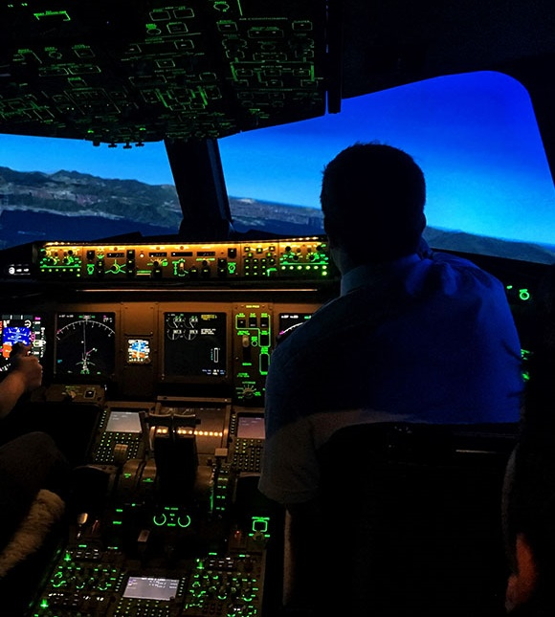
A pilot study allows researchers to identify potential issues, evaluate the feasibility of the study, and make necessary adjustments before investing significant time and resources into the main study.

Slide 4

Define Objectives: Clearly outline the objectives of your pilot study. Know what specific research questions you want to address and what you hope to learn from the pilot.
Data Collection Methods: Choose the data collection methods that will be used in the main study.
Pre-Testing: Before conducting the pilot study, pre-test the data collection tools. This will help identify any issues with the instruments and allow for necessary refinements.
Data Analysis: Analyse the data collected during the pilot study. While the sample size is small, you can still gain valuable insights from the data that can inform adjustments for the main study.
Identify Issues and Make Adjustments: Carefully assess the results of the pilot study and identify any potential issues or challenges. Based on the findings, make necessary adjustments to the study design, data collection methods, and procedures.
Assess Feasibility: Evaluate the feasibility of the main study based on the experiences and lessons learned from the pilot study.
Documentation: Document the methodology, findings, and adjustments made during the pilot study.
Ethical Considerations: Ensure that the pilot study adheres to ethical guidelines for research involving human participants. Obtain the necessary approvals and informed consent from participants.

Slide 5

PROJECT MANAGEMENT

Slide 6

600hrs of study
85 days @7hrs
(16x work weeks)*
*Times approx. based on 60 credits = 600 notional hours of study
Notes:
Your must spend 400hrs of study WHICH IS 57 days @7hrs (11x 37 hour work week) or just under 3 months work

Slide 7

REPORT 1 (20%) - 30/10/2023 Pilot Study/feasibility/progress
REPORT 2 (70%) - 8/01/2024 Final Report Presentation (10%) -15/01/2024 Viva & Q&A

Slide 8

IT’S TOUGH

Slide 9

BEGIN

Slide 10

THINK

Slide 11

PLAN

Slide 12

RESEARCH

Slide 13

STUDY

Slide 14

THINK

Slide 15

SKILL UP

Slide 16

READ

Slide 17

Logbook
Project “Memory”

Slide 18

Project Library
Project “scrapbook”
Notes:
Project Library A project library should be kept and maintained throughout the duration of the project. This will provide evidence for the claims you make in your written report, and the information held in it should be cross-referenced to your logbook. This may be developed either on paper or digitally.
Your project library should contain any copied or original material pertinent to the project. It may hold:
Copied journal articles
Reference material
Information obtained from websites
Technical literature
Specifications and other documents developed during the project (under revision control)
Data collected from surveys and feedback
Test results
Evidence of or links to documentation off experimentation
The project tutor will also wish to see the project library to ensure that background study is taking place in support of the project.

Slide 19

Microsoft OneNote, Slack, Notion, GitHub and cloud storage such as MicrosoftOne Drive and Google Drive.
There are several tools to help you create reference, bibliography lists and add Citations in MS Word and Google Docs such should as ProQuest RefWorks, mybib.com/, mendeley.com or similar plus Google Scholar for finding and collecting referenced sources.

Slide 20

FRAMEWORKS
Notes:
build you artifact

Slide 21
Annotated Bibliography - Structure
KRUGER, JUSTIN & DUNNING, DAVID, 1999. Unskilled and Unaware of It: How Difficulties in Recognizing One's Own Incompetence Lead to Inflated Self-Assessments. (Statistical Data Included). Journal of Personality and Social Psychology, 77(6), pp.1121–34.
http://dx.doi.org/10.1037/0022-3514.77.6.1121
1
Harvard Reference
1
Harvard Reference
2
Overview
3
Summary
4
Evaluation
5
Usefulness

Slide 22

Implementation
Notes:
This part of the Project will document the implementation, testing or the conduct of the investigation of your project. There will also be discussion on any issues/problems that arose and how each was resolved. This section will provide evidence of your problem-solving abilities and should clearly indicate that you are willing to look to external sources for information and develop your personal skill-set to resolve problems
The Design and Implementation planning you discussed within the Review Report (AE1), will now be applied to your project which will include designing, creating your artefact, testing and validation, all of which will be documented in your Logbook and Project Library.
Make sure you allocate enough time to complete this major part of your project and still leave time to comfortably write up the Final Report (AE2).

Slide 23
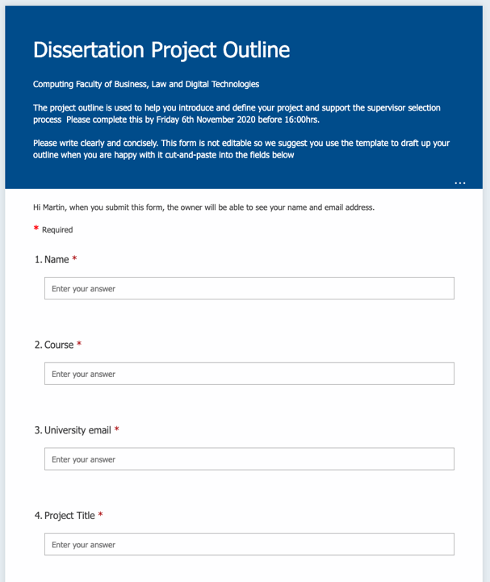

Project Proposal Outline - NOT GRADED Monday 4th Sept 2023
Notes:
You will need to have chosen your Project Topic ready for the Project Outline submission 4pm- 18/10/19.

Slide 24

Report 1 (20%)
Notes:
You will start the Final Project write up once the implementation phase is complete and your project has the required outcomes
You will already have documentation in your Logbook/Project Library, plus the work undertook within the review report, and it is this information you will draw from to write up your Final Report. If this information is complete and well organised it will make the write-up a straight forward process. An overview of academic reporting can be found here in this Handbook.
You should have allocated an enough time to write your report within your project planning.
Create a project outline for each of your sections and subsections then roughly allocate how many words you intend to write in each of these, also specify what references/citations, diagrams and tables you intend to include. REMEMBER the assessment gives a suggested structure which covers the main headings, you will need to break these down into sub-sections to give your report clarity.
When you are writing each section of your report it is important you think about what you want to get across before starting. You will also need to connect ideas/theme from each of your paragraphs or sections this is called signposting.
Make sure you have time to redraft what you have written - it may well be the case you do this several times.
More details on academic writing, report writing, referencing and dissertations can be found on Succeed@Solent.

Slide 25
The first assessment (AE1) will be a Project Pilot Study report which will document the feasibility and possible approaches for your project You will gain feedback on to move forward to the second assessment element (AE2). Report 20% - 3000 Words (+/- 10%)

Slide 26
Suggested structure for the first assessment element Pilot/Feasibility Report You will be offered a template to support the structure and presentation of your report in this module.
Introduction This section should contain background and context to your proposed project including the aims and objectives of your project. Backed up with citation.
You should also address the Research Question, Problem Statement or Hypothesis to test. This section should be broken down into appropriate subsections.
Methodology In this section you will present your proposed research methodology and methods you intend to use to drive your project, source literature, collect analyse and present data. Backed up with citation. This section should be broken down into appropriate subsections. Which should include the following:
Ethical Considerations - including reference to the signed off ethical release form Project management - including a snapshot of milestones.

Slide 27
Pilot Study This section will contain documentation of practical implementation conducted within your pilot study. This will help to prove that your project is viable, feasible and that you have the right skills and resources to undertake and evaluate the project.
Conclusion. This section will remind the reader of what you have set out to do and we will wrap up with a convincing argument that your project is viable to proceed to the next phase.
References. References should be presented in the Solent University Harvard (SU) style and will consist of a good range of quality sources (reviewed journals etc)
Appendices. Appendices should contain extra evidence to back up the body of the report. In this report one of the appendices will contain a signed off ethical release form - which will also be presented in the final 10,000-word dissertation report

Slide 28

Report 20% - 3000 words (+/-10%)
30/10/2023 4pm

Slide 29

Tools & Platforms

Slide 30
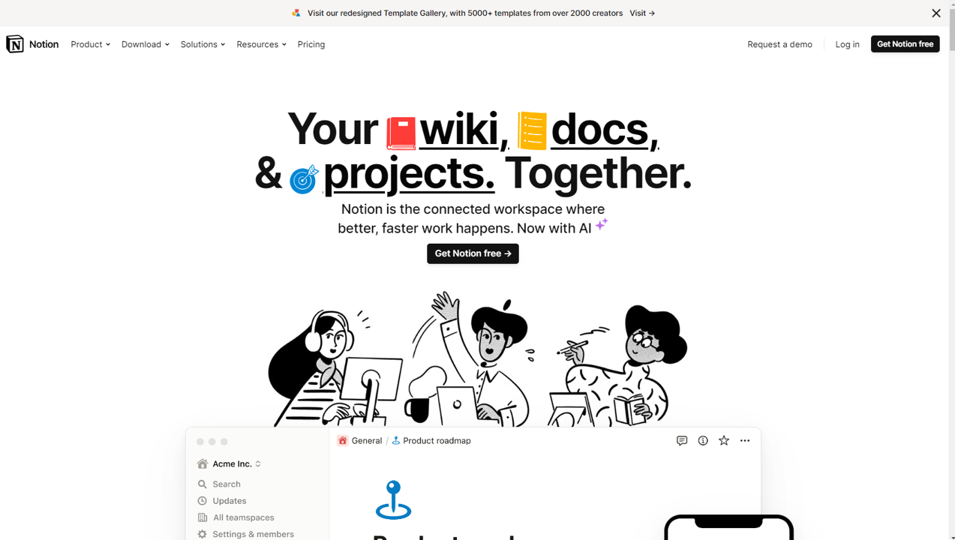
https://www.notion.so/

Slide 31

https://www.notion.so/help/notion-for-education

Slide 32
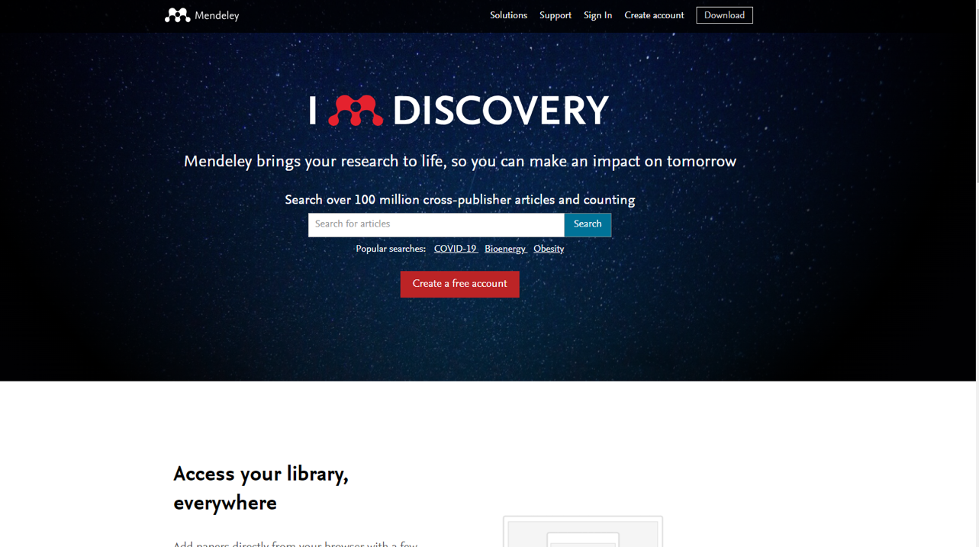
https://www.mendeley.com/

Slide 33
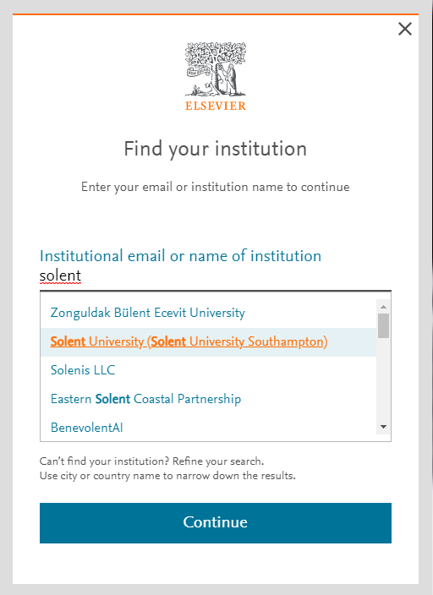
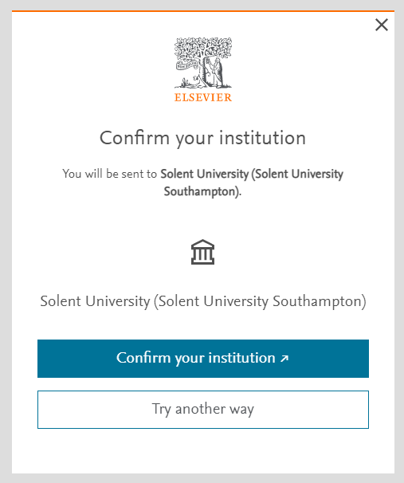

Slide 34
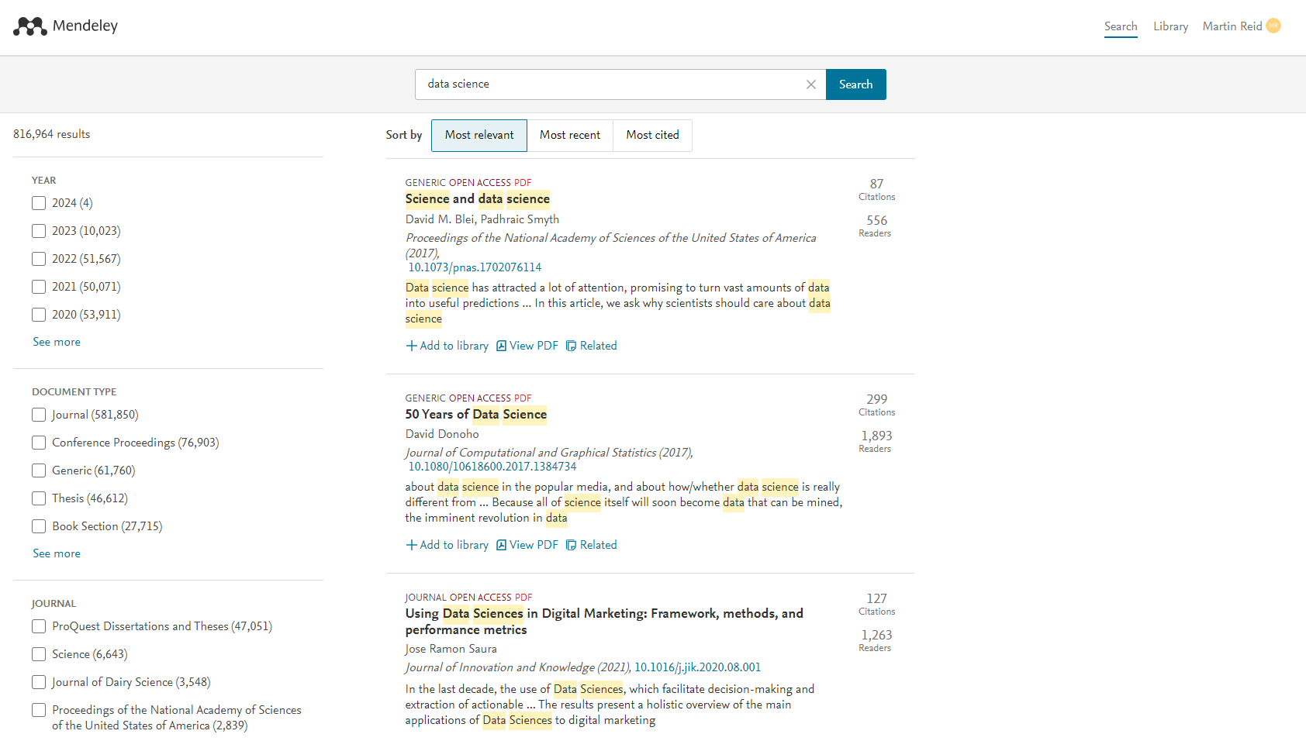
https://www.mendeley.com/

Slide 35
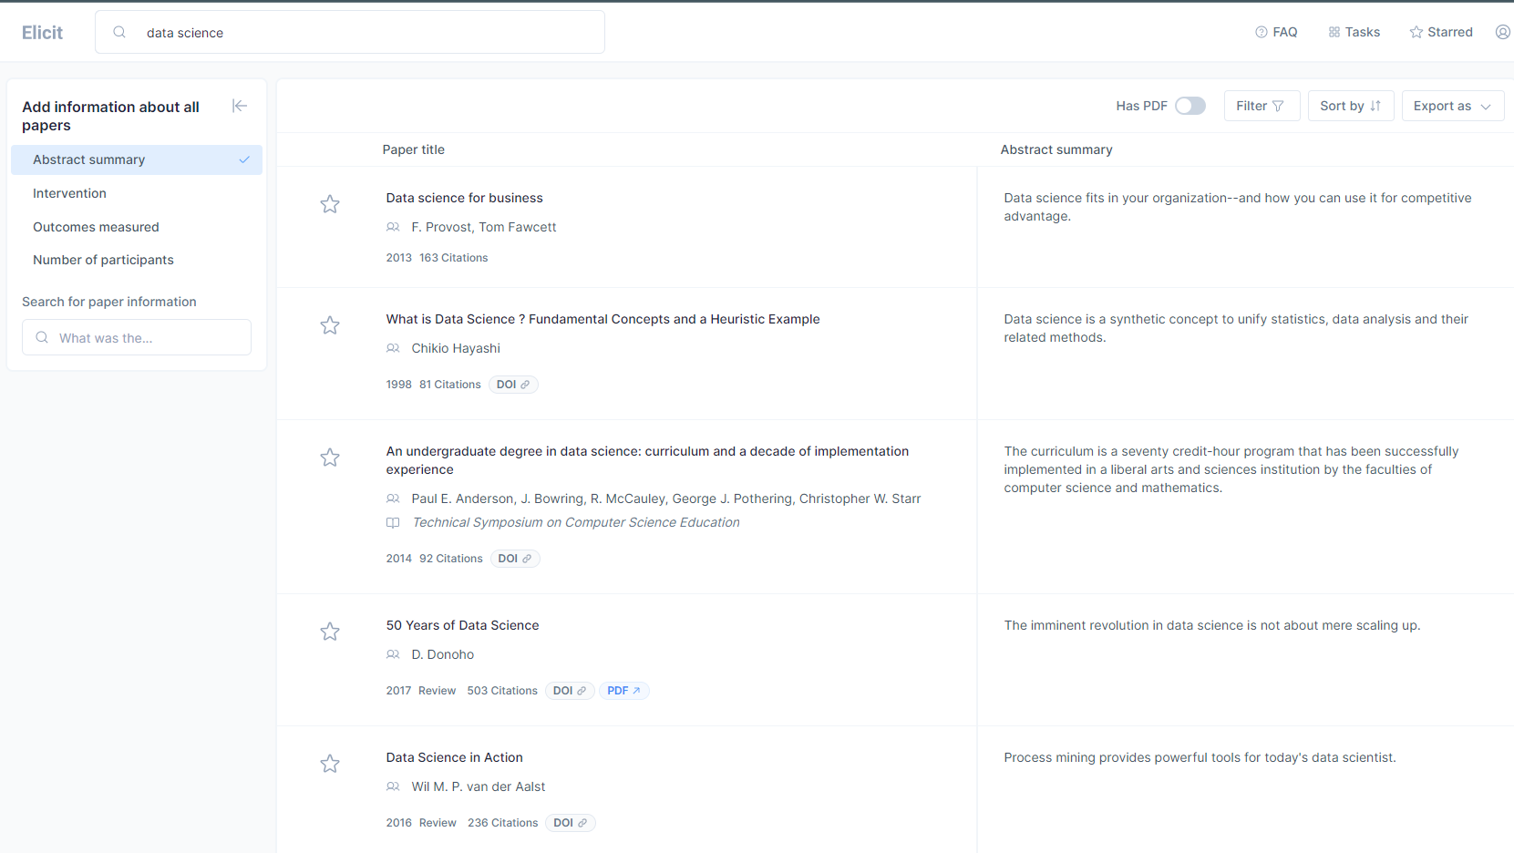
https://elicit.org/

Slide 36
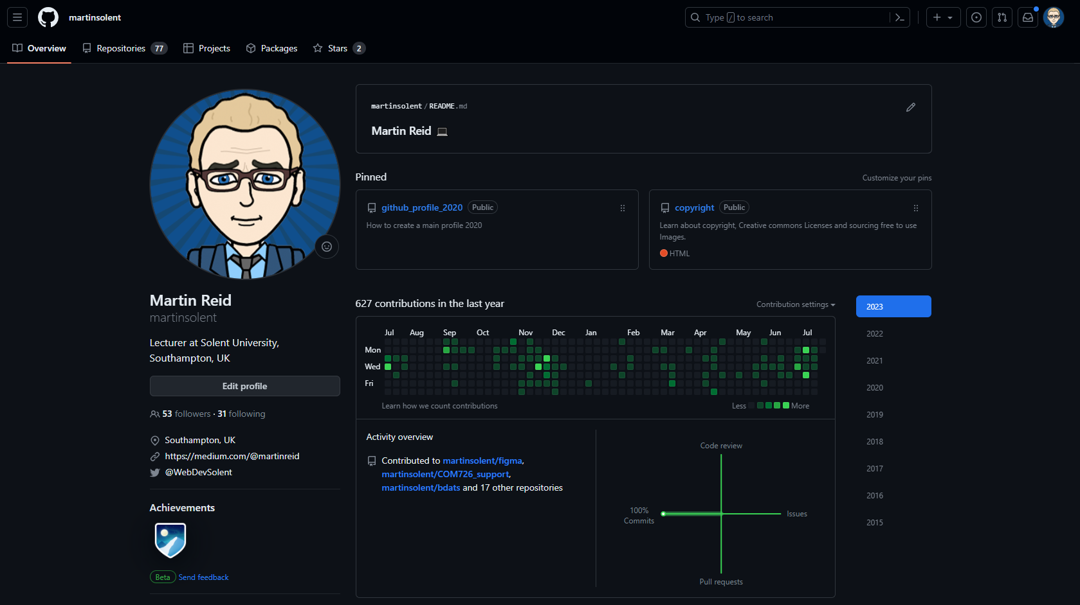
https://github.com

Slide 37
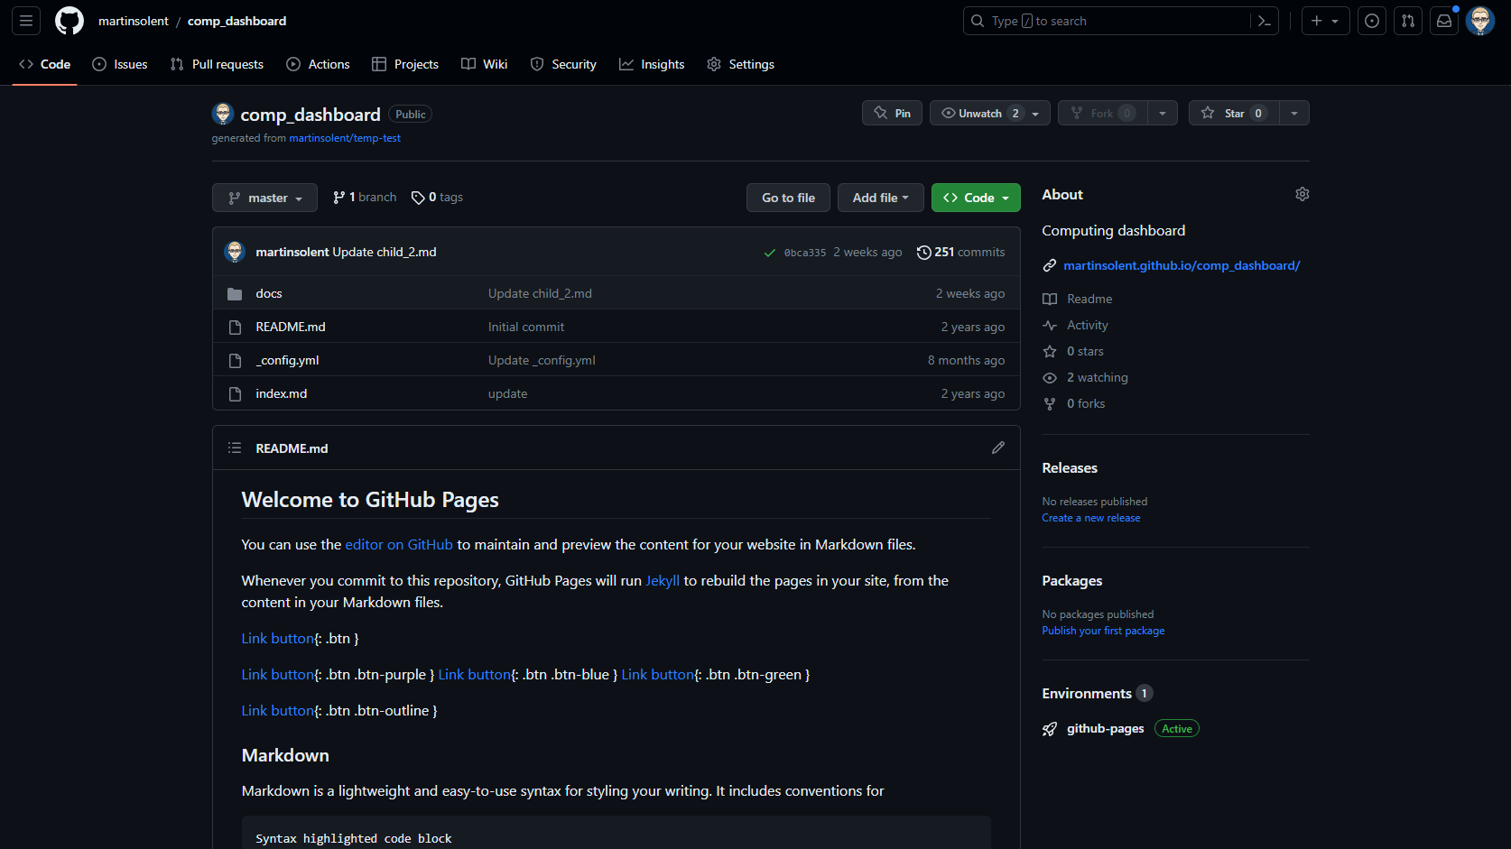

Slide 38
Thank you

